Slide 1
Microsoft Azure Cloud Adoption Security Review
[Name]
[Title]
[Organization Name]

Slide 2
Agenda
Why follow the Cloud Adoption Secure Methodology?
Overview: Cloud Adoption Secure Methodology
How to get started with Cloud Adoption Security
Resources
Notes:
<Key Point>: Agenda
● Why is being well-architected important?
● Overview: Microsoft Azure Well-Architected Framework
● Overcoming workload quality inhibitors
● Resources & Amplification

Slide 3
PLACEHOLDER FOR Cloud Adoption Security Review Slide

Slide 4
PLACEHOLDER FOR Cloud Adoption Security Review Slide

Slide 5
PLACEHOLDER FOR Cloud Adoption Security Review Slide

Slide 6
PLACEHOLDER FOR Cloud Adoption Security Review Slide

Slide 7


[CA_Security_Review]
Report generated [Report_Date]

Slide 8

Executive Summary
Areas of focus to raise your Cloud Adoption Security Review Score
Number of high-impact recommendations per focus area:
[S1]
[Domain_1]
Cloud Adoption Security Review Score
[S2]
[Domain_2]
[Sc]
[S3]
[Domain_3]
[Cloud_Adoption_SR_Description]
[S4]
[Domain_4]
[S5]
[Domain_5]
[S6]
[Domain_6]
[S7]
[Domain_7]
[S8]
[Domain_8]

Slide 9
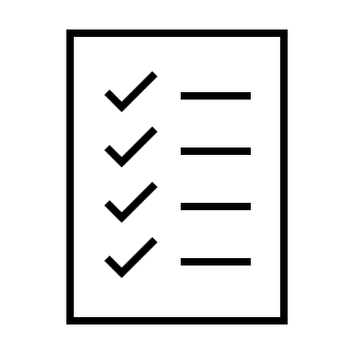
[Domain_Title]
Top X out of Y recommendations:
Focus Area relative weight
[Placeholder_Text_1]
Relative weight indicates the average importance of recommendations in this section
[Sc]
[Domain_Description]

